Slide 1
Campaign Date
Reviews
Testing
High Level Tasks

Slide 2
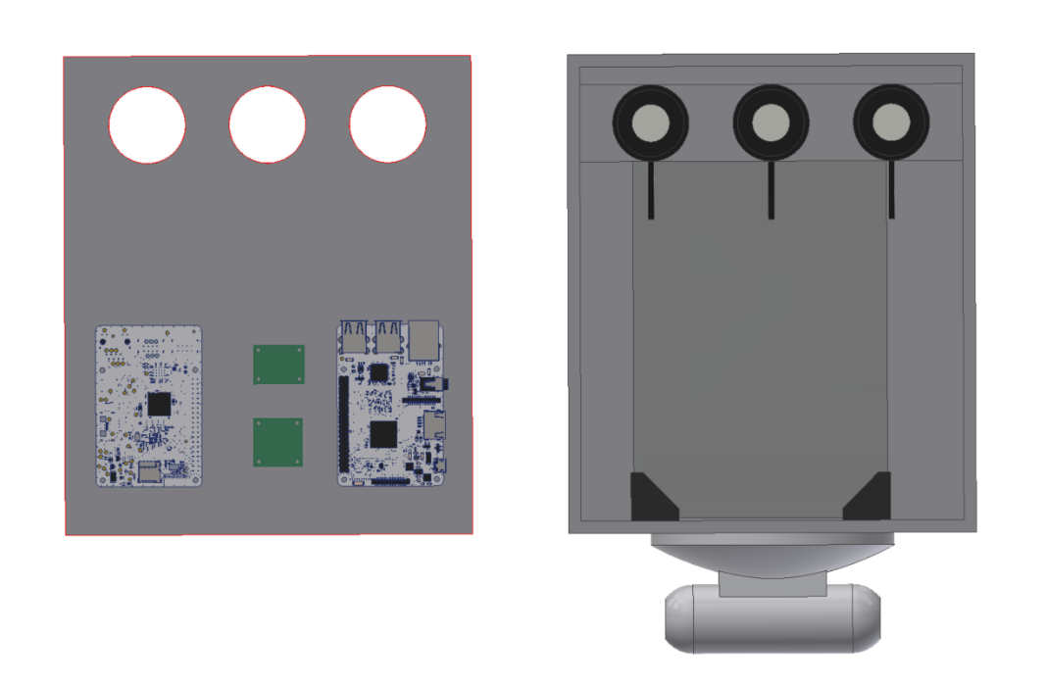
Wallops Ambient Light Radiometer & Ultraviolet Sensor Suite (WALRUSS) Sarah Roth – University of Wallops
IRAD
Fully characterizing the ultraviolet exposure of the balloon and associate materials in-flight will allow for a greater understanding of material degradation in-flight. This will help design materials to withstand ultra-long duration missions and decided if certain materials can be reused which will increase safety parameters and lower costs.
Build a custom sensor package that can fly as a piggyback on multiple missions. Sensor package should be able to be modified and allow for additional sensors. Data storage onboard and independent of all CSBF power/equipment.
EXAMPLE
April 2021
Drew is completing software design and testing
Final wiring schematic is in progress and final layout of hardware
Structural analysis packet is in progress
Work Plan/ Quad Chart | 9/30/2020
Source ozone sensors/ solar power components | 9/30/2020
Software requirements delivered to 589 | 10/15/2021
Flight application submitted | 12/20/2021
Structural Analysis and Paperwork submitted to MM | 4/15/2021
Bench testing complete | 5/1/2021
T-Vac testing complete | 6/30/2021
Integration at Ft. Sumner | 8/1/2021
Additional purchases may be needed for hardware
Must allocate remaining funds by 5/1

